Slide 1
Artificial Neural Network (ANNs)

Slide 2
Contents
Introduction
Neural Network Representation
Appropriate Problems
Perceptrons
Representational power of perceptrons
The perceptron training rule
Gradient descent and the delta rule
Derivation of the Gradient descent rule
Multilayer Networks and BackPropagation Algorithms

Slide 3
Introduction
Artificial Neural Network (ANNs) provide a general, practical method for learning real-valued (continuous,always numeric), discrete-valued(numeric or categorical) and vector-valued functions from examples.
Algorithms such as BACKPROPAGATION use gradient descent to tune network parameters to best fit a training set of input - output pairs.
ANN learning is robust to errors in the training data & has been successfully applied to problems such as interpreting visual scenes, speech recognition and learning robot control strategies.

Slide 4
Biological Motivation
According to estimation the human brain contains a densely interconnected network of approximately 10^11 neurons each connected on average to 10^4 others.
Neuron activity is typically excited or inhibited through connections to other neurons.
The fastest neuron switching times are known to be on the order of 10^-3 seconds quite slow compared to computer switching speeds of 10^-10 seconds.

Slide 5
Contd….
But still humans are able to make surprisingly complex decisions, surprisingly quickly.
Example
It requires approximately 10^-1 seconds to visually recognize our mother.
Notice the sequence of neuron firings that can take place during this 10 ^ -1 seconds interval, which is very less than each neuron switching time (10^-3)
This observation led to start thinking of Artificial Neural Network (ANNs)
In this regard two teams started working towards ANN's, one is regarding Biological learning system and another one is Machine Learning.

Slide 6
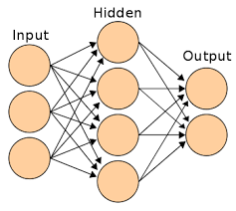
Representation of Artificial Neural Network (ANN’s)
Each node (circle) in the network diagram corresponds to the output of a single network unit and the lines entering the node from below are its input.
As the name suggests, a neural network is a collection of connected artificial neurons.

Slide 7
Contd….
We will focus on the most common and practical ANN approaches, which are based on the BACKPROPAGATION algorithm.
The BACKPROPAGATION algorithm assumes the network is a fixed structure that corresponds to a directed graph, possibly containing cycles.
Learning corresponds to choosing a weight value for each edge in the graph.

Slide 8
Appropriate Problems for Neural Network Learning
ANN learning is well - suited to problems in which the training data corresponds to noisy, complex sensor data such as inputs from cameras and microphones.
The BACKPROPAGATION algorithm is the most commonly used ANN learning technique.
It is appropriate for problems with the following characteristics

Slide 9
Characteristics
Instances are represented by many attribute - value pairs.
The target function output may be discrete - valued, real - valued, a vector of several real or discrete - valued attributes.
The training examples may contain errors (Noise in the data).
Long training times are acceptable.
Fast evaluation of the learned target function may be required.
The ability of humans to understand the learned target function is not important.

Slide 10
ANN Architectures
Single-Layer Feed-Forward NNs: One input layer and one output layer of processing units. No feedback connections (e.g. a Perceptron)
Multi-Layer Feed-Forward NNs: One input layer, one output layer, and one or more hidden layers of processing units. No feedback connections (e.g.a Multi-Layer Perceptron)
Recurrent NNs: Any network with at least one feedback connection. It may, or may not, have hidden units
Notes:
For a ANN mapping two dimensions to one dimension, as in reproducing the AND or the OR (or XOR) functions, you can think of a neuronal network as doing the following:
On the 2d plane mark all positions of input vectors. So, for boolean values, you’d want to mark (-1,-1), (1,1), (-1,1), (1,-1). What your ANN now does is drawing a straight line on the 2d plane, separating the positive output from the negative output values.
Without bias, this straight line has to go through zero, whereas with bias, you’re free to put it anywhere. So, you’ll see that without bias you’re facing a problem with the AND function, since you can’t put both (1,-1) and (-1,1) to the negative side. (They are not allowed to be on the line.) The problem is equal for the OR function. With a bias, however, it’s easy to draw the line.
Note that the XOR function in that situation can’t be solved even with bias.
Modification of neuron WEIGHTS alone only serves to manipulate the shape/curvature of your transfer function, and not its equilibrium/zero crossing point.
The introduction of BIAS neurons allows you to shift the transfer function curve horizontally (left/right) along the input axis while leaving the shape/curvature unaltered. This will allow the network to produce arbitrary outputs different from the defaults and hence you can customize/shift the input-to-output mapping to suit your particular needs.

Slide 11
Perceptrons
In machine learning, the perceptron is an algorithm for supervised learning of binary classifiers (functions that can decide whether an input, represented by a vector of numbers, belongs to some specific class or not).
It is a type of linear classifier, i.e. a classification algorithm that makes its predictions based on a linear predictor function combining a set of weights with the feature vector.
The simplest kind of neural network is a single-layer perceptron network, which consists of a single layer of output nodes; the inputs are fed directly to the outputs via a series of weights.
In the literature the term perceptron often refers to networks consisting of just one of these units.

Slide 12
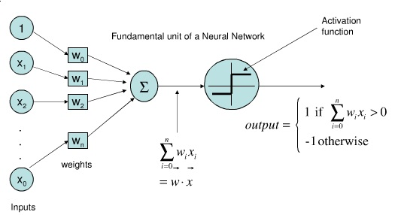
Perceptrons (Artificial Neuron)
One type of ANN system is based on a unit called a perceptron.

Slide 13
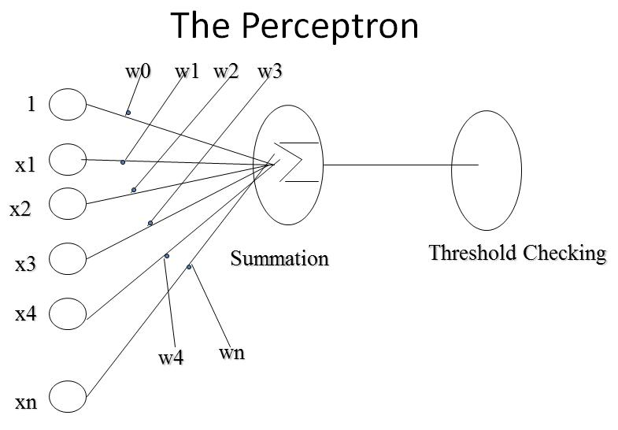

Slide 14
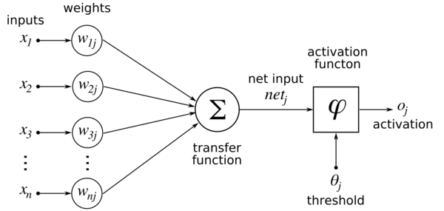

Slide 15
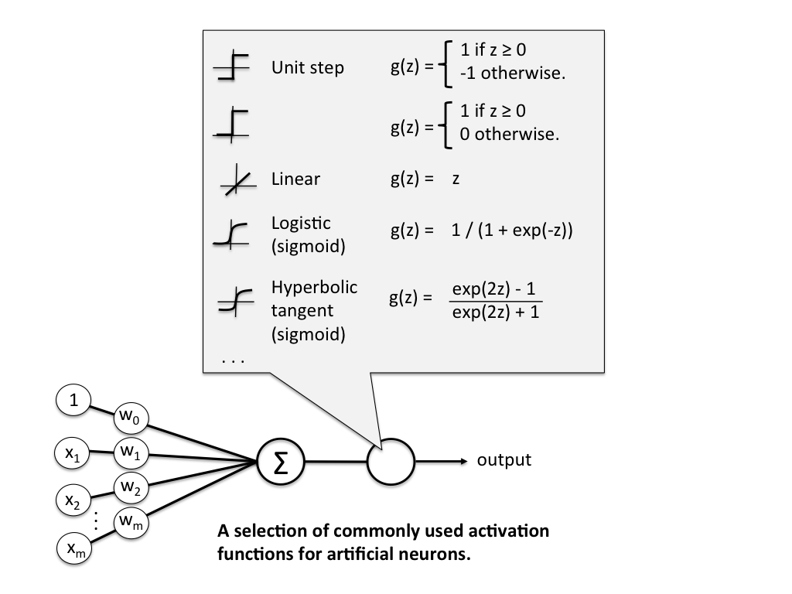

Slide 16
Representational Power of Perceptrons
A perceptron represents a hyperplane decision surface in the n-dimensional space of instances.
Some sets of examples cannot be separated by any hyperplane, those that can be separated are called linearly separable.
A single perceptron can be used to represent many boolean functions.
AND, OR, NAND, NOR

Slide 17
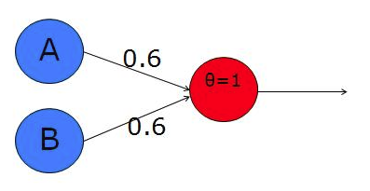
Implementation of AND
To do this, we want the sum of both inputs to be greater than the threshold, but each input alone must be lower than the threshold. Let's use a threshold of 1 (simple and convenient!). So, now we need to choose the weights according to the constraints I've just explained - how about 0.6 and 0.6? With these weights, individual activation of either input A or B will not exceed the threshold, while the sum of the two will be 1.2, which exceeds the threshold and causes the neuron to fire.

Slide 18
Contd….
If A=0 & B=0 --> 0*0.6 + 0*0.6 = 0. This is not greater than the threshold of 1, so the output = 0. Good!
If A=0 & B=1 --> 0*0.6 + 1*0.6 = 0.6. This is not greater than the threshold, so the output = 0. Good.
If A=1 & B=0 --> exactly the same as above. Good.
If A=1 & B=1 --> 1*0.6 + 1*0.6 = 1.2. This exceeds the threshold, so the output = 1. Good.

Slide 19
Rules for adjusting the weights
Two ways
Perceptron training rule
Gradient Descent and delta rule

Slide 20
The Perceptron Training Rule
Perceptron will learn to classify any linearly separable set of inputs.
Classies a linearly separable set of inputs
problem:
Determine a weight vector w that causes the perceptron to produce the correct output for each training example.

Slide 21
Perceptron Training Rule:
W_{i} = W_{i} + △W_{i}
_{Where} △W_{i} = η ( t - o ) x_{i}
_{Here,}
t = target output
o = perceptron output
η = learning rate (usually some small value, e.g. 0.1)

Slide 22
Algorithm
Initialize w to random weights
repeat, until each training example is classified correctly
apply perceptron training rule to each training example
Convergence guaranteed provided linearly separable training examples and sufficiently small
Note: perceptron rule fails if data is not linearly separable

Slide 23
Gradient descent and delta rule
This rule is suitable for non linear also
If the training examples are not linearly separable, the delta rule converges toward a best-fit approximation to the target concept
The key idea behind the delta rule is to use gradient descent to search the hypothesis space of possible weight vectors to find the weights that best fit the training examples.
Gradient descent provides the basis for the BACKPROPAGATION algorithm, which can learn networks with many interconnected units

Slide 24


The delta training rule is best understood by considering the task of training an unthreshold perceptron;
The output o is given by
To compute error

Slide 25
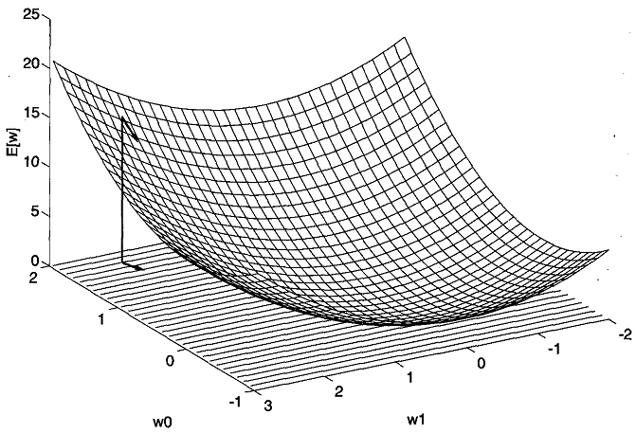


Slide 26
Gradient descent search determines a weight vector that minimizes E by
starting with an arbitrary initial weight vector, then repeatedly modifying it in
small steps.
At each step, the weight vector is altered in the direction that produces
the steepest descent along the error surface.
This process continues until the global minimum error is reached

Slide 27



DERIVATION OF THE GRADIENT DESCENT RULE
The weight update rule for gradient descent is
The derivation of the above rule is given below:
After assuming initial values for weight vector, we update the w as below
WHERE
OR

Slide 28
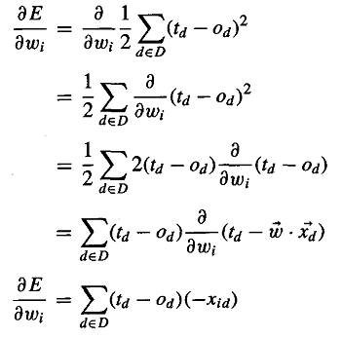

td is constant value, result is 0
dw/dw = 1, hence vector w is 1

Slide 29
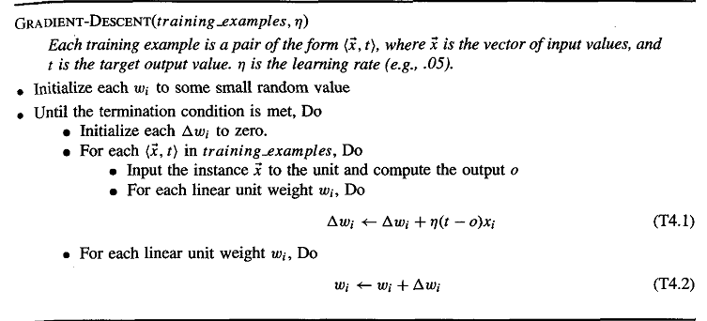
Gradient descent algorithm

Slide 30
STOCHASTIC APPROXIMATION TO GRADIENT DESCENT
The gradient descent training rule computes weight updates after summing over all the training examples in D
The idea behind stochastic gradient descent is to approximate this gradient descent search by updating weights incrementally, following the calculation of the error for each individual example.

Slide 31
Differences between standard gradient descent and stochastic gradient descent
In standard gradient descent, the error is summed over all examples before updating weights, whereas in stochastic gradient descent weights are updated upon. Summing examining each over multiple examples in standard gradient training example.
Summing examining each over multiple examples in standard gradient training example. descent requires more computation per weight update step. On the other hand, because it uses the true gradient, standard gradient descent is often used with a larger step size per weight update than stochastic gradient descent.
In cases where there are multiple local minima with respect to E ( w ), stochastic gradient descent can sometimes avoid falling into these local minima because it uses the various ∇E d ( w )rather than ∇E ( w )to guide its search.

Slide 32
MULTILAYER NETWORKS AND THE BACKPROPAGATION ALGORITHM
Single perceptrons can only express linear decision surfaces
The kind of multilayer networks learned by the BACKPROPAGATION algorithm are capable of expressing a rich variety of nonlinear decision surfaces
A typical multilayer network and decision surface is
the speech recognition task involves distinguishing among 10 possible vowels
all spoken in the context of "h-d" (i.e., "hid," "had,") etc
The input speech signal is represented by two numerical parameters obtained from a spectral analysis of the sound, allowing us to easily visualize the decision surface over the two-dimensional instance space

Slide 33
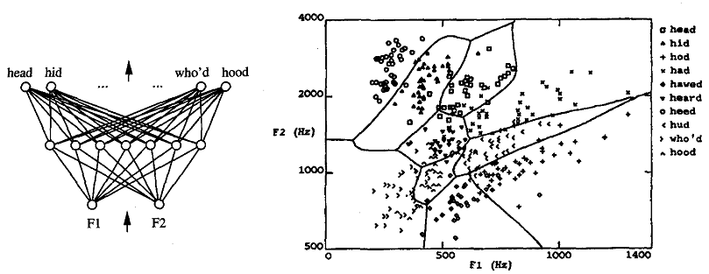

Slide 34
A Differentiable Threshold Unit (Activation function)
For constructing multilayer neural network we need unit whose output is a nonlinear function of its inputs, but whose output is also a differentiable function of its inputs
One solution is the sigmoid unit-a unit very much like a perceptron, but based on a smoothed, differentiable threshold function
Here the Activation function is used to produce non linear output for example
Logistic Sigmoid
Hyperbolic tangent sigmoid

Slide 35
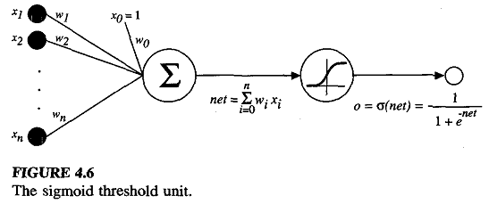
Sigmoid unit (logistic/hyperbolic)
Like the perceptron, the sigmoid unit first computes a linear combination of its inputs, then applies a threshold to the result
In the case of the sigmoid unit, however, the threshold output is a continuous function of its input ie from 0 to 1 or -1 to 1 (Whereas in perceptron the output 0 OR 1)

Slide 36


Contin….
the sigmoid unit computes its output o as
Where
σ is called sigmoid/logistic function and its output ranges from 0 to 1
Because it maps a very large input domain to a small range of outputs, it is often referred to as the squashing function of the unit.
Mlayer nw is meant for non linear classification, to achieve this we need threshold unit(activation function) which converts linear i/p to non linear o/p,

Slide 37

The BACKPROPAGATION Algorithm
The BACKPROPAGATION algorithm learns the weights for a multilayer network,given a network with a fixed set of units and interconnections
It employs gradient descent to attempt to minimize the squared error between the network output values and the target values for these outputs.
Because we are considering networks with multiple output units rather than single units as before, we begin by redefining E to sum the errors over all of the network output units

Slide 38
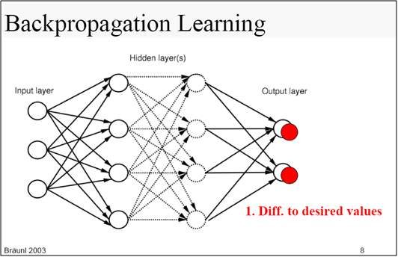

Slide 39
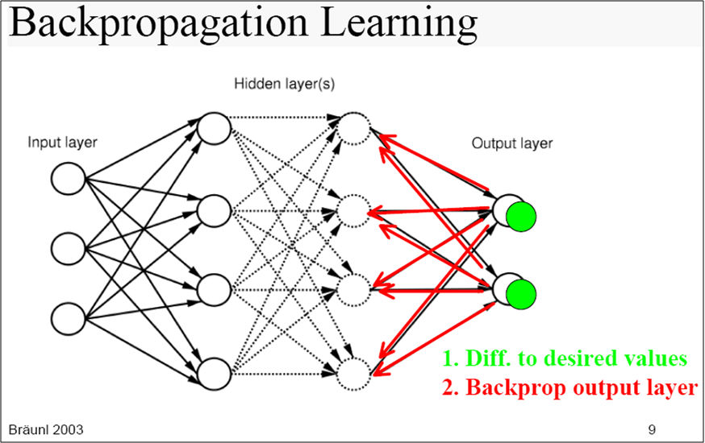

Slide 40
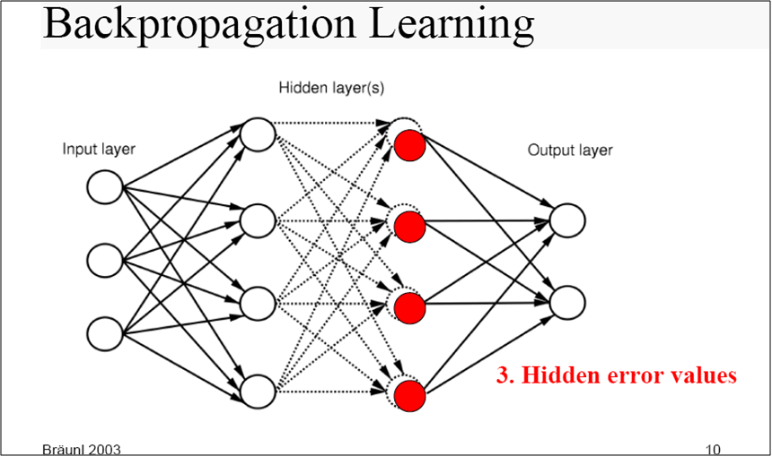

Slide 41
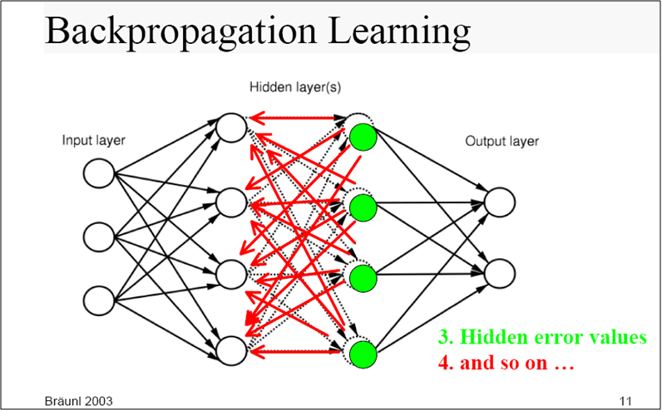

Slide 42
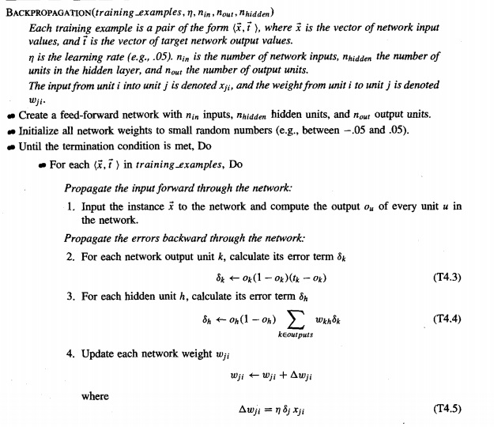

Slide 43
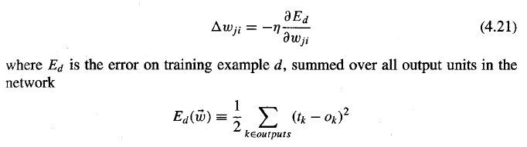
Derivation of the BACKPROPAGATION Rule

Slide 44
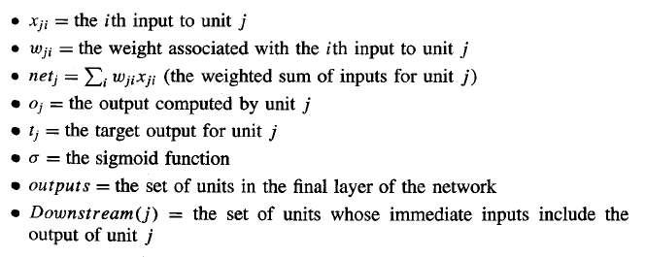

Slide 45
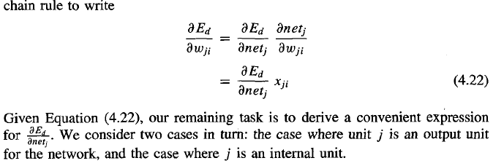
Contd….

Slide 46
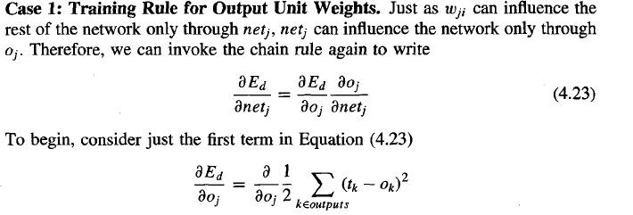
Training Rule for Output Unit Weights

Slide 47
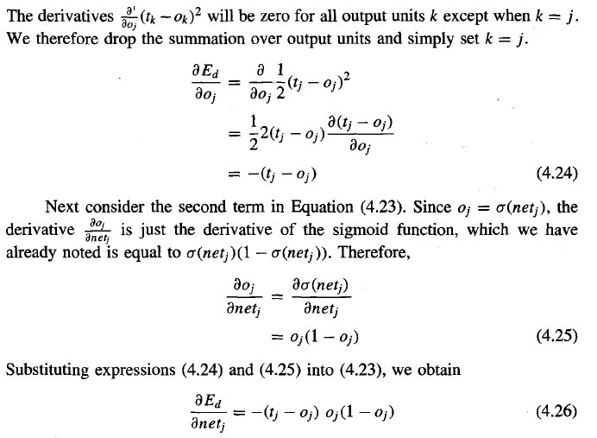

Slide 48
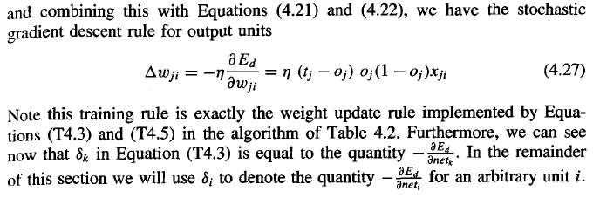

Slide 49
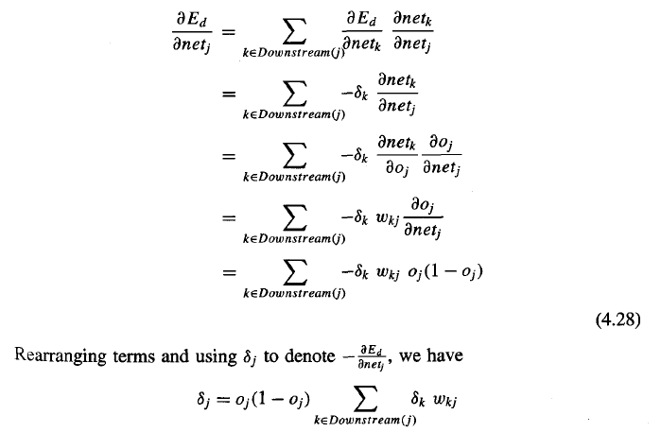

Slide 50
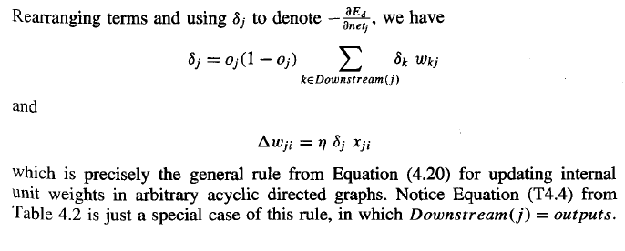

Slide 51
Delta Rule
Gradient descent is a first-order iterative optimization algorithm for finding the minimum of a function.
To find a local minimum of a function using gradient descent, one takes steps proportional to the negative of the gradient (or of the approximate gradient) of the function at the current point.
The delta rule uses gradient descent rule to search the hypothesis space of possible weight vectors to find the weights that best fit the training examples.
http://ml-cheatsheet.readthedocs.io/en/latest/gradient_descent.html#introduction

Slide 52
Contd….
Gradient descent is a technique to find a minimum of a function.
Question is how to find a minimum of a function?
From calculus, minimum of a function can be computed by applying differentiation.
Notes:
https://www.quora.com/Why-does-deep-learning-architectures-only-use-the-non-linear-activation-function-in-the-hidden-layers/answer/David-Kobilnyk?srid=Lfu1
https://towardsdatascience.com/multi-layer-neural-networks-with-sigmoid-function-deep-learning-for-rookies-2-bf464f09eb7f

Slide 53
Gradient Descent Algorithm

Slide 54
References
https://mattmazur.com/2015/03/17/a-step-by-step-backpropagation-example/
http://www.emergentmind.com/neural-network
weight
An element of a weight matrix. A connection between two neurons with a value that is dynamically changed during a neural net's learning process.
weight matrix
The connection structure between two neuron layers of a neural net. Its elements, the weights, are changed during the net's learning process. Each neural net has at least one weight matrix.
https://towardsdatascience.com/activation-functions-and-its-types-which-is-better-a9a5310cc8f

